Slide 1
Grafică asistată de calculator
Laborator – Grigore Ionuț

Slide 2
Laboratory 9
VQGAN: Converting
Images into Sequences
of Integers

Slide 3
Lab Overview
01
Image → Integer Sequence
02
Encoder + quant_conv
Use a pretrained VQGAN to convert a fish image into 576 integers and reconstruct it back.
The VQGAN encoder compresses 3×384×384 to 256×24×24 using 4 strided convolutions (16× downsampling).
03
Codebook Quantization
04
Integer Sequence → Image
model.quantize() finds the nearest codebook vector for each of the 576 latent patches, replacing it with a discrete index.
Map each index back to its codebook embedding, reshape, pass through post_quant_conv + decoder → 3×384×384 image.
05
Reconstruction quality
Compare images reconstructed from quantized vectors vs sequences of integers — they are identical, proving lossless round-trip through the codebook.

Slide 4
Context — What Is VQGAN ?
VQGAN
VQ-VAE
GAN

Slide 5
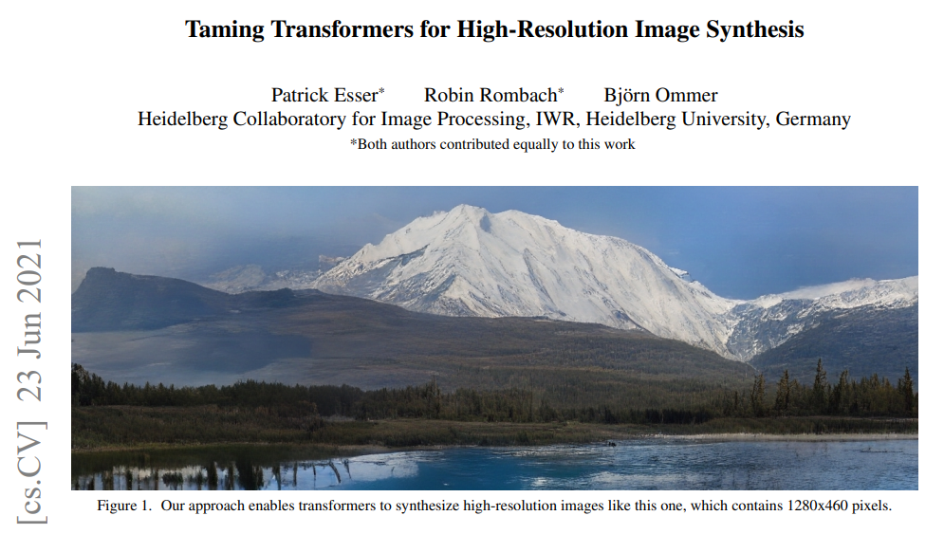
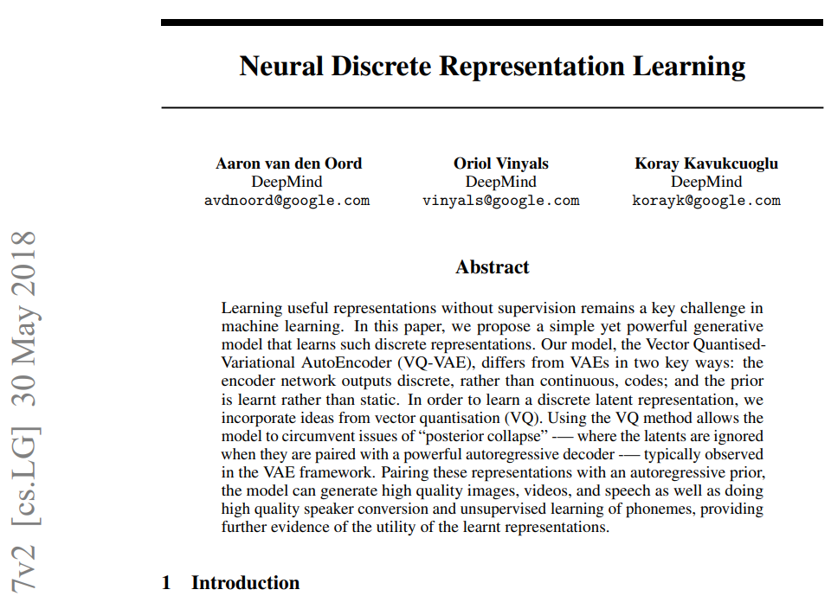
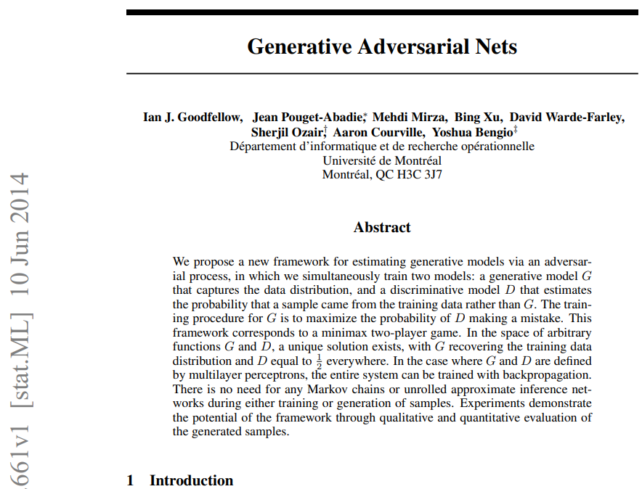
Context — What Is VQGAN ?
https://arxiv.org/pdf/2012.09841
https://arxiv.org/pdf/1711.00937
https://arxiv.org/pdf/1406.2661

Slide 6


Slide 7
Section 1
What is an autoencoder?

Slide 8
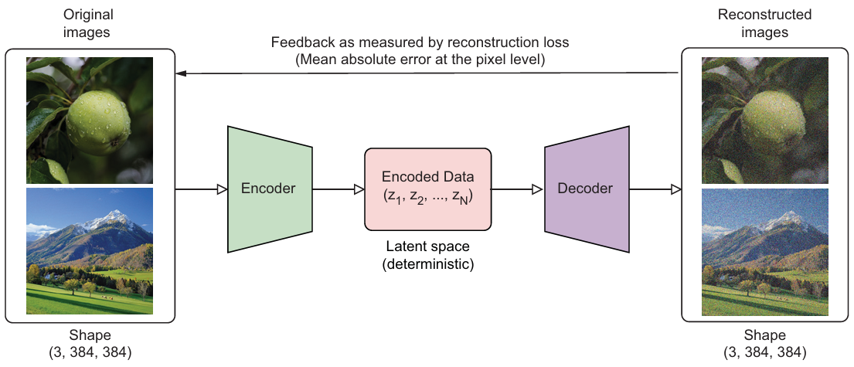
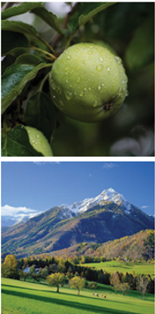


An autoencoder is a neural network that learns to compress data and then reconstruct it — learning only from the data itself, with no labels.
TL;DR: A compressed, lower-dimensional version of the input which encodes the most essential features learned during training.

Slide 9
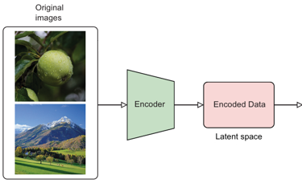
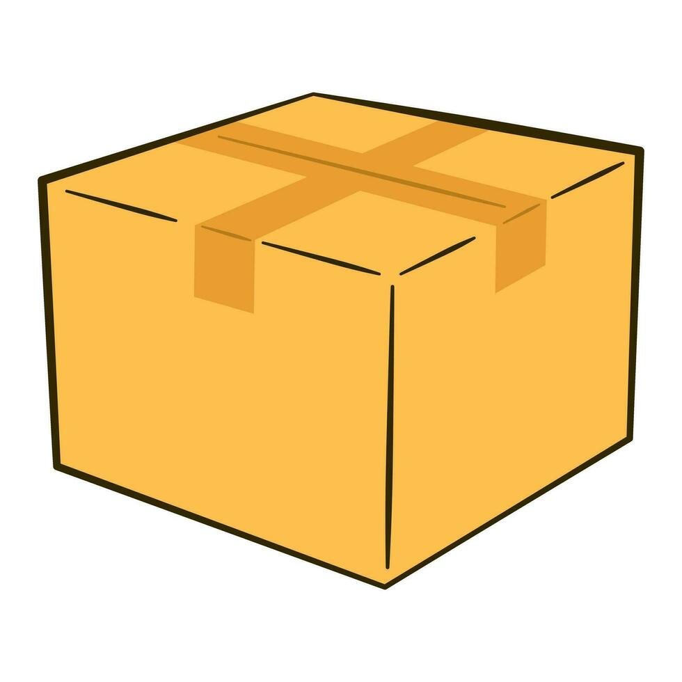
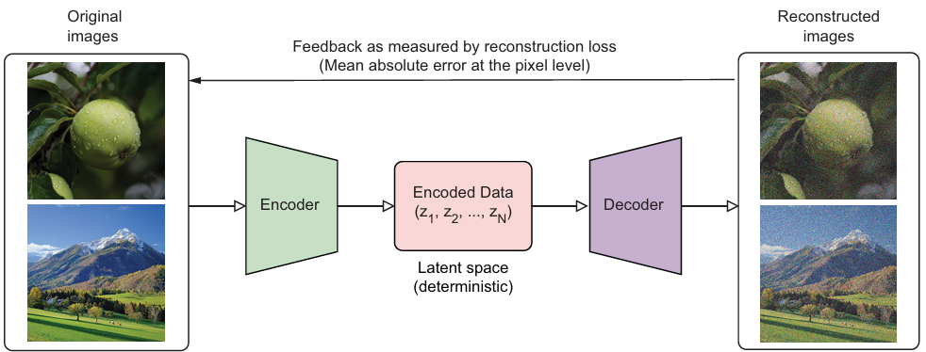


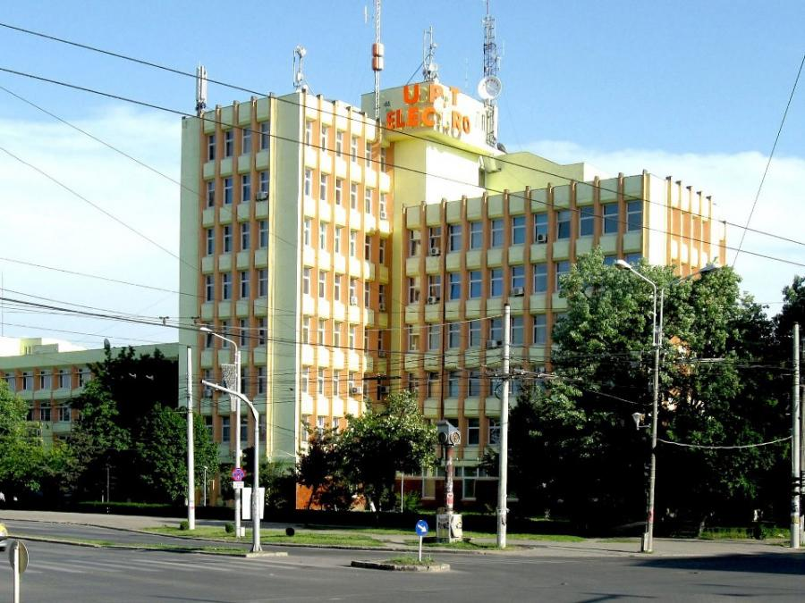

✅ What Autoencoders Do Well
Image compression — reduce storage while keeping key features
Anomaly detection — flag inputs that reconstruct poorly

Slide 10
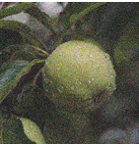
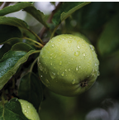
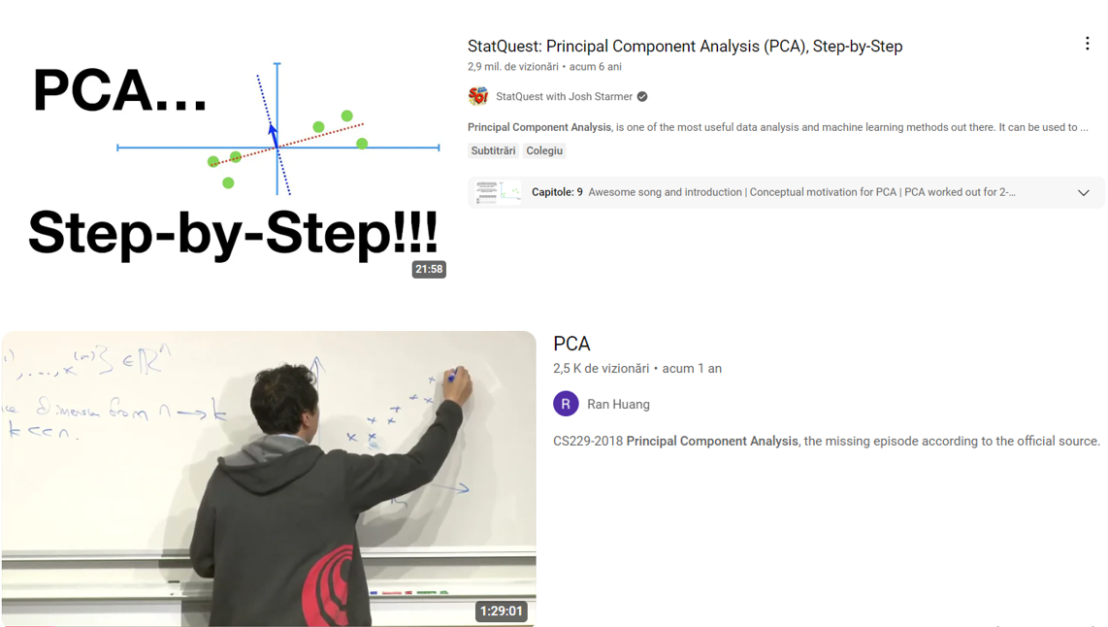



✅ What Autoencoders Do Well
Denoising — remove noise from corrupted images
Noise
Noisy Image
Reconstructed Image
Dimensionality reduction — alternative to PCA

Slide 11
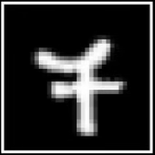
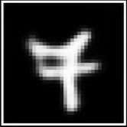
❌ What Autoencoders Do Bad
Poor generative ability — designed for reconstruction, not sampling novel realistic images.
Encoder
z
Decoder
0.23
…
0.63
z
Latent representation
Latent space

Slide 12
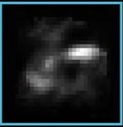
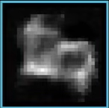
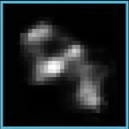
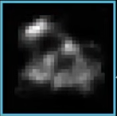
❌ What Autoencoders Do Bad
Poor generative ability — designed for reconstruction, not sampling novel realistic images.
If we randomly sample points from the latent space and run them through the decoder, they will not produce useful results because the latent space is disorganized and irregular !
z₁
z₂
Latent space
z₄
Decoder
z₃

Slide 13

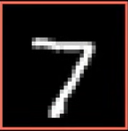
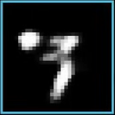
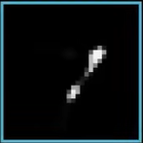
❌ What Autoencoders Do Bad
Poor generative ability — designed for reconstruction, not sampling novel realistic images.
If we sample around an encoded image in latent space, nearby points often fail to produce meaningful variations, while points too close simply reconstruct the original image !
z₁
z₂
Encoder
z_{ref}
Decoder
z₃

Slide 14


Slide 15
Section 2
What is a variational
autoencoder (VAE) ?

Slide 16
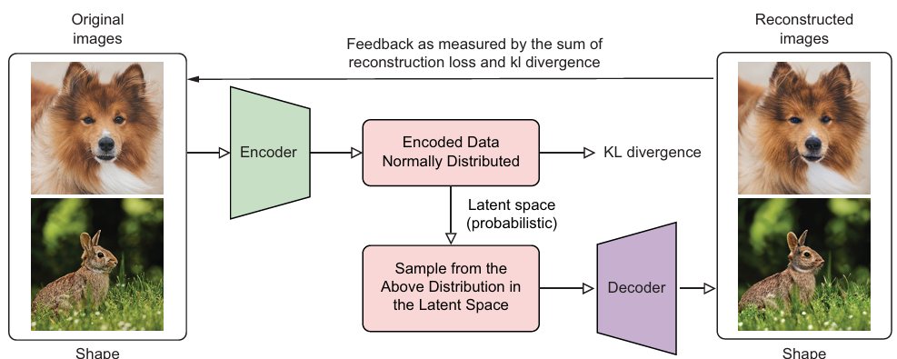

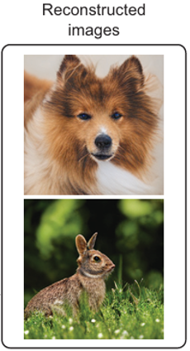
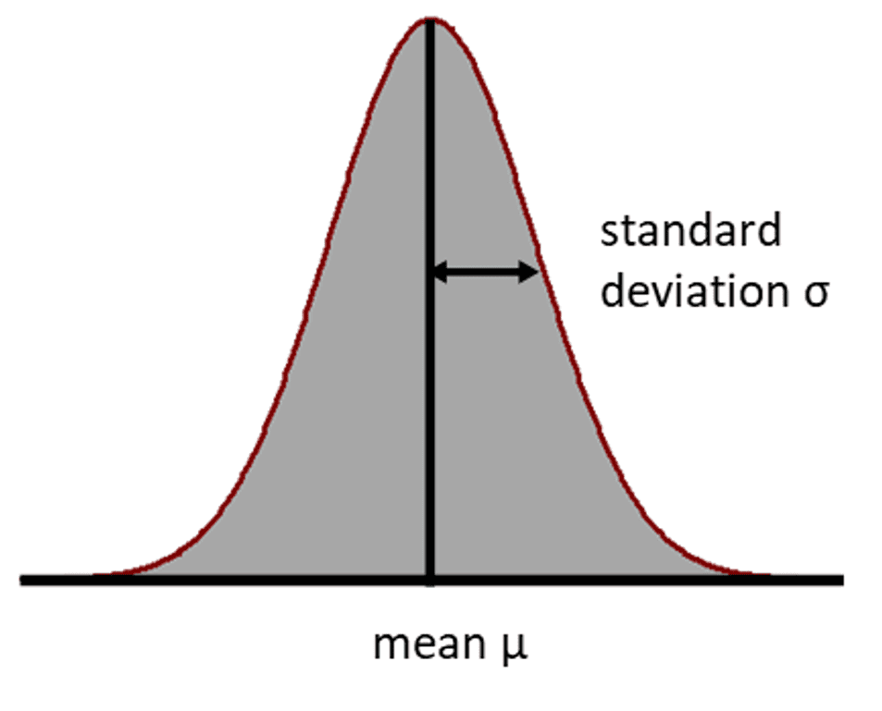


A variational autoencoder is a neural network that learns to encode data into a probability distribution (Gaussian) and then generate reconstructions by sampling from it — enabling the generation of new, realistic images.

Slide 17


Encoder
z
Decoder

Slide 18
But we have another problem….

Slide 19
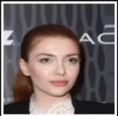
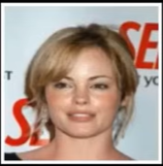
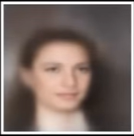
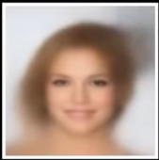
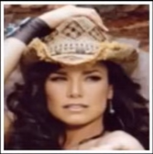
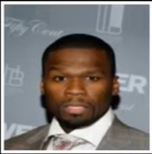
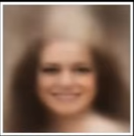
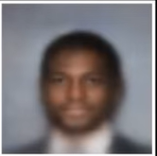

VAE produces blurry images
CelebA dataset
Reconstructions
Averaging over possibilities — the decoder samples from a distribution and averages multiple possible reconstructions, producing blurry, imprecise outputs.
Continuous latent space is underused — large regions remain empty or sparsely populated, making generation less efficient and less sharp.

Slide 20
Section 3
What is a vector quantized variational autoencoder (VQ-VAE) ?

Slide 21
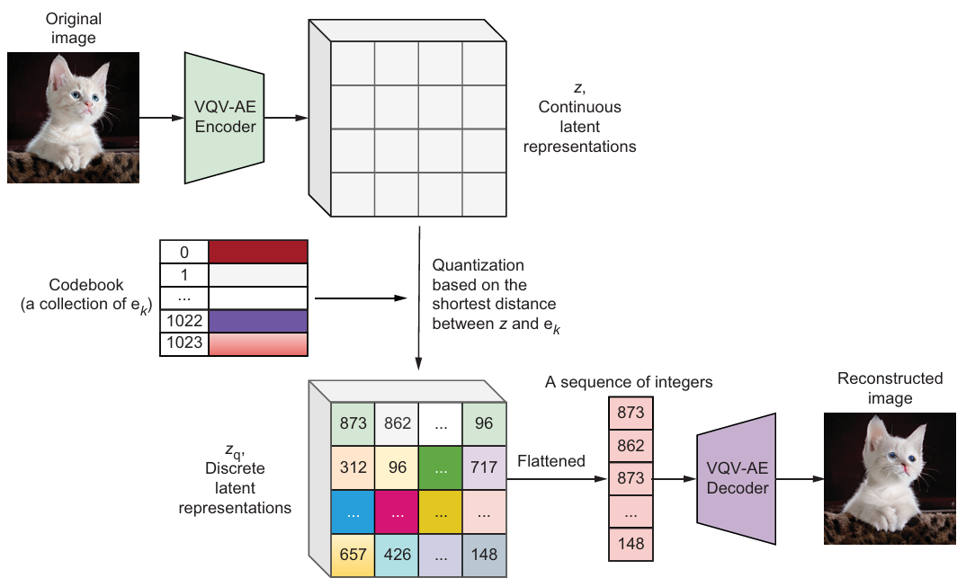






VQ-VAE Encoder
Each such a piece is called a feature vector within the latent space. For each feature vector from the encoded image, we identify the nearest embedding vector in the codebook and replace the feature vector with this closest match.
Codebook
(a collection of embedding vectors e_{k})
VQ-VAE Decoder

Slide 22

Just a bit of theory
3 Core Components:
Encoder — compresses input images into continuous latent vectors
Codebook — a finite set of discrete embedding vectors; each latent vector is replaced by its nearest match
Decoder — reconstructs the image from the discrete (quantized) embeddings
How Quantization Works:
Each image is encoded into a grid of feature vectors (e.g. 24×24 = 576 vectors)
Each feature vector is matched to the nearest embedding in the codebook (e.g. 1024 embeddings)
The result is a sequence of integers — each representing a codebook index (e.g. 873, 862, …, 148) — a compact discrete representation of the image.
Two Loss Functions:
Reconstruction loss — difference between original and reconstructed image
Quantization loss — how closely encoder outputs match their assigned codebook embeddings

Slide 23
Section 4
What is a generative adversarial network (GAN) ?

Slide 25
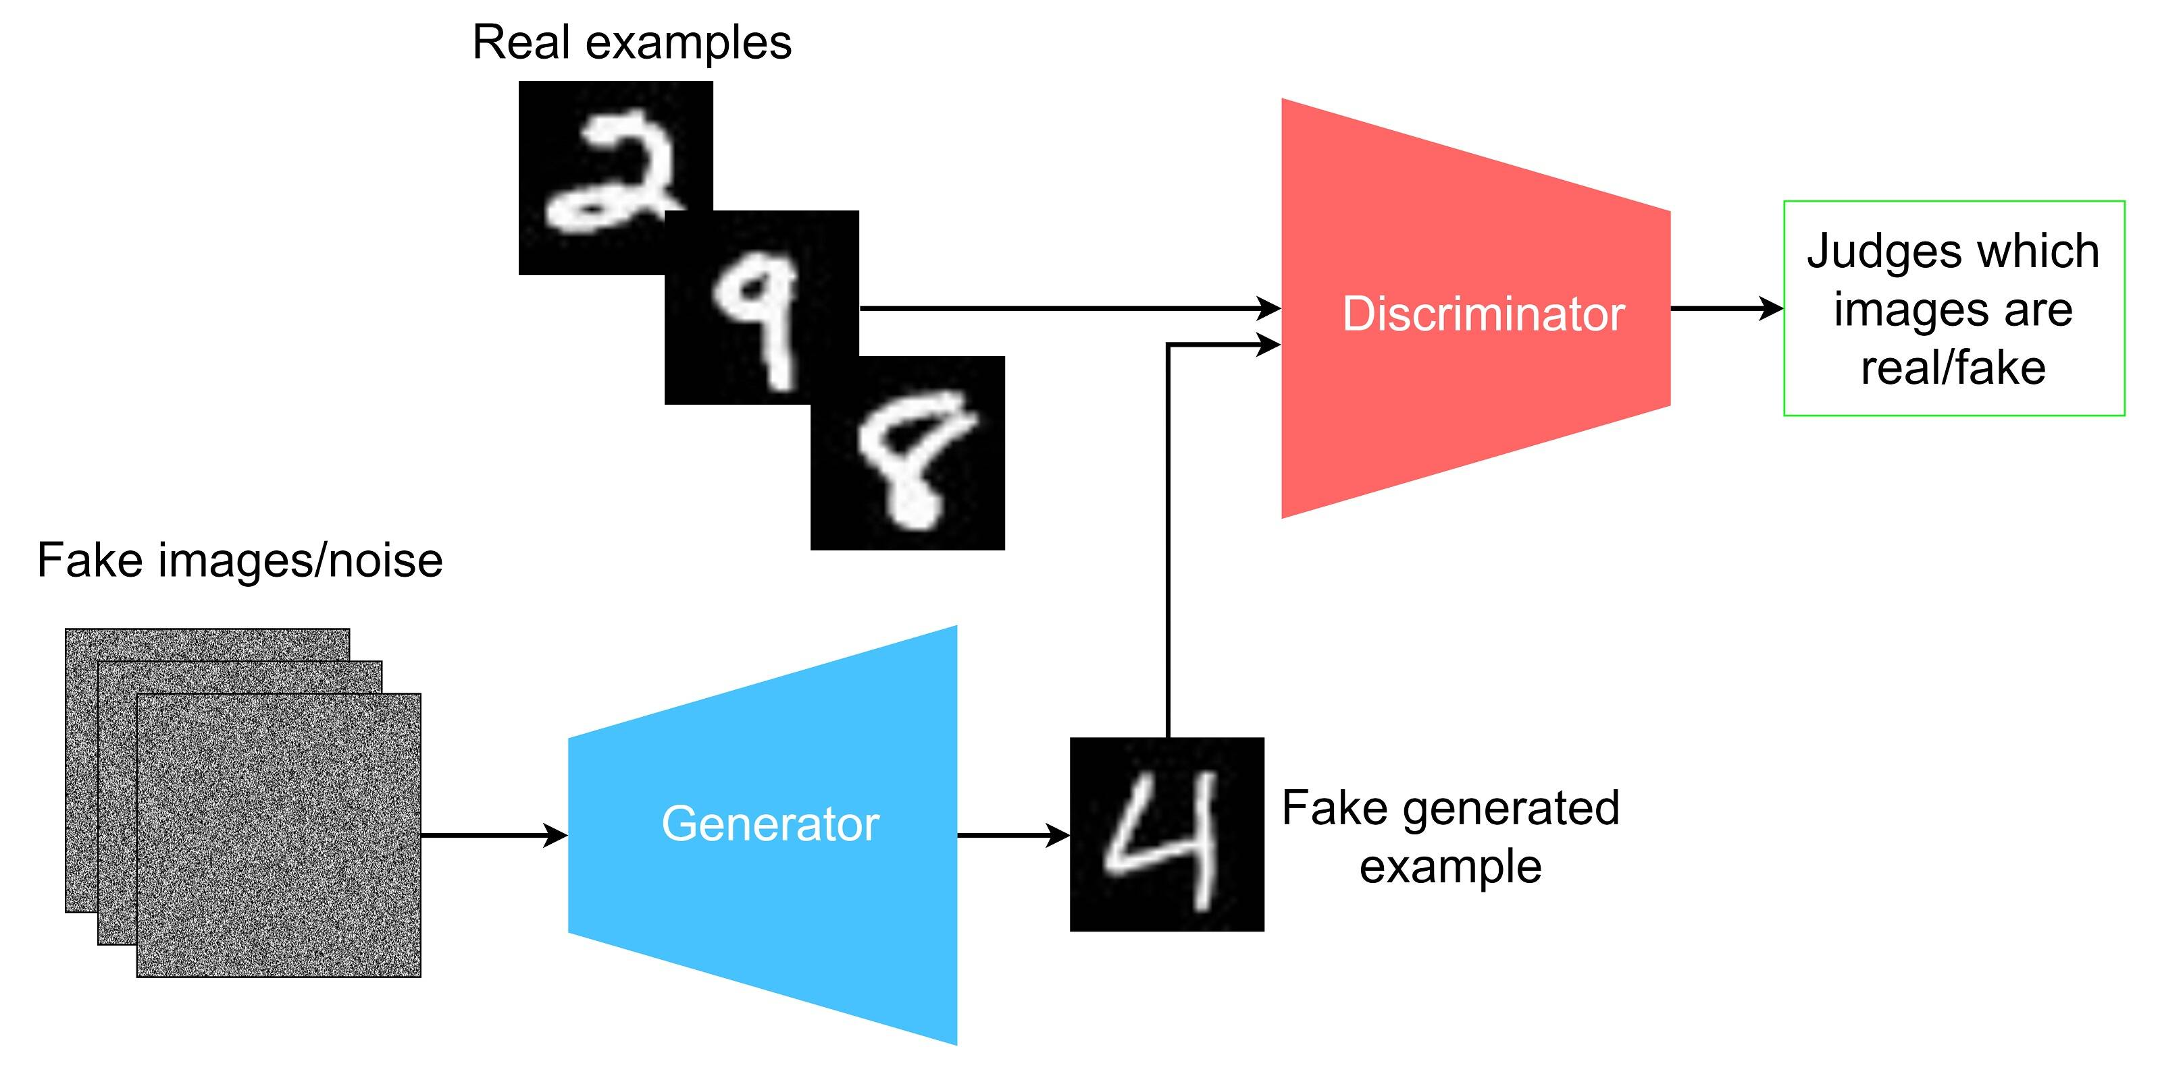

Random noise

Slide 26
Just a bit of theory
GANs are a class of generative models built on a game-theoretic framework between two competing neural networks:
Generator—Takes random noise, typically sampled from a normal distribution, and transforms it into synthetic data samples that aim to resemble the real data distribution.
Discriminator—Receives both real samples from the training set and generated samples from the generator, and then attempts to correctly classify them as real or fake.
The generator and discriminator engage in a two-player minimax game:
The discriminator seeks to maximize its ability to distinguish real samples from fakes.
The generator aims to minimize the discriminator’s ability to correctly identify fake samples.

Slide 27
Section 5
What is a Vector Quantized Generative Adversarial Network (VQGAN) ?

Slide 28
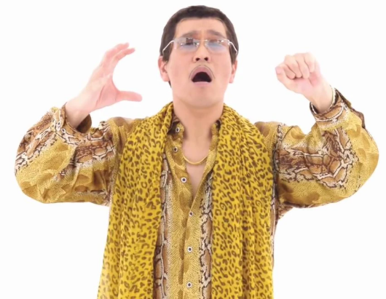
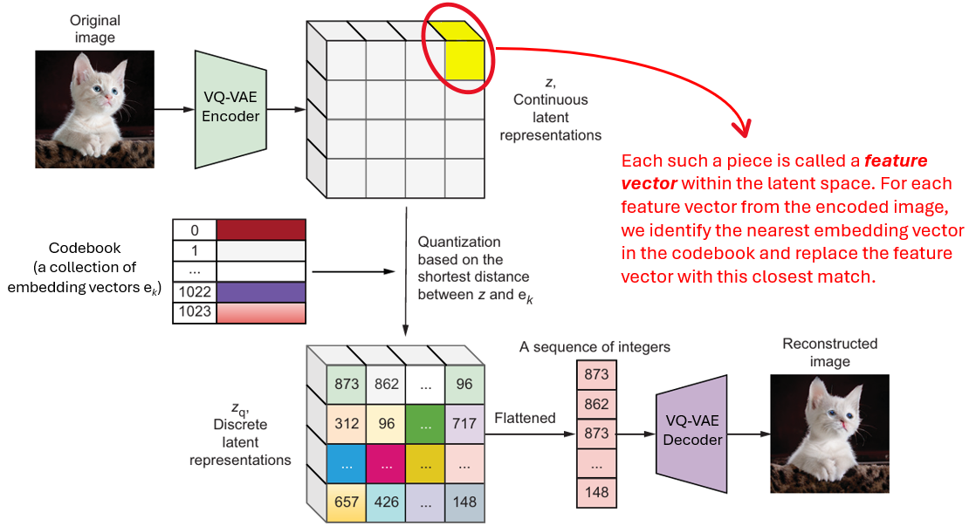
VQ-VAE
GAN

Slide 29
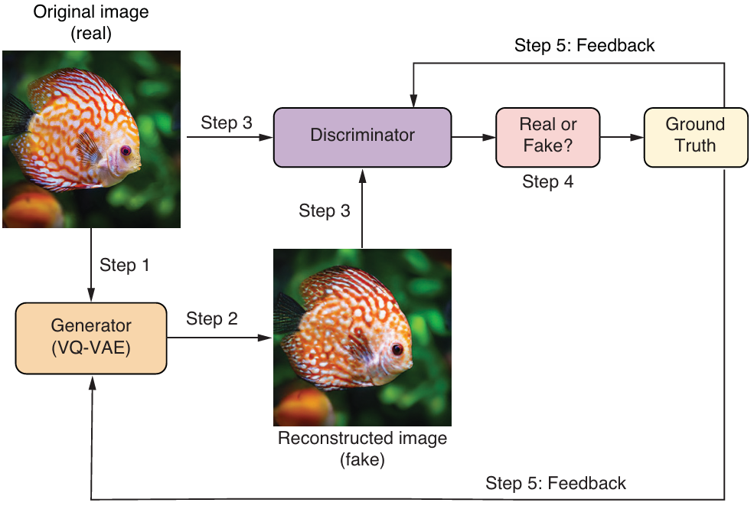

Slide 30
Section 1
The Full
VQGAN Pipeline:
Image ↔ Integers

Slide 31
Quick Demo: Fish Image → 576 Integers → Reconstructed Image
Downloads and loads the pretrained VQGAN model:
import requests, os
import torch
from omegaconf import OmegaConf
from taming.models.vqgan import VQModel
torch.set_grad_enabled(False) # Disables gradient computation to speed up inference
device = "cuda:0" if torch.cuda.is_available() else "cpu"
url1=('https://heibox.uni-heidelberg.de/f/140747ba53464f49b476/?dl=1')
url2=('https://heibox.uni-heidelberg.de/f/6ecf2af6c658432c8298/?dl=1')
file1="files/vqgan_imagenet_f16_1024.ckpt"
file2="files/vqgan_imagenet_f16_1024.yaml" # Defines URLs and filenames for the model weights and configuration
if not os.path.exists(file1):
fb=requests.get(url1)
with open(file1,"wb") as f:
f.write(fb.content) # If the weights file is missing, download it from the specified URL.
if not os.path.exists(file2):
fb=requests.get(url2)
with open(file2,"wb") as f:
f.write(fb.content) # If the configuration file is missing, download it from the specified URL.
def load_model():
config = OmegaConf.load(file2) # Loads model configuration
model = VQModel(**config.model.params).to(device) # Imports the VQGAN model from the GitHub repository
sd = torch.load(file1)["state_dict"]
missing, unexpected = model.load_state_dict(sd, strict=False) # Loads pretrained weights to the VQGAN model
return model

Slide 32
Quick Demo: Fish Image → 576 Integers → Reconstructed Image
Defines functions to encode an image into 576 integers and decode them back into an image:
import PIL
import torchvision.transforms as T
import torchvision.transforms.functional as TF
def process_image(file_name): # Defines a process_image() function to center crop images and resize them
size=384
img=PIL.Image.open(file_name)
s = min(img.size)
r = size / s
s = (round(r * img.size[1]), round(r * img.size[0]))
img = TF.resize(img, s, interpolation=PIL.Image.LANCZOS)
img = TF.center_crop(img, output_size=2 * [size])
return torch.unsqueeze(T.ToTensor()(img), 0)*2-1
def image_to_sequence(model,image):
z=model.encoder(image.to(device))
z=model.quant_conv(z)
z_q, _ , indices= model.quantize(z)
int_sequence = indices[2]
return int_sequence
def sequence_to_image(model,sequence):
z_q2 = model.quantize.embedding(sequence)
z_q2 = z_q2.permute(1,0).view((1,256,24,24))
z_post2 = model.post_quant_conv(z_q2)
z_recon2 = model.decoder(z_post2)
return z_recon2

Slide 33
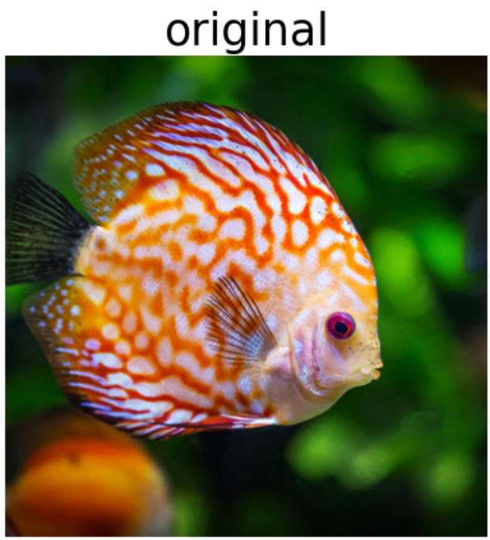
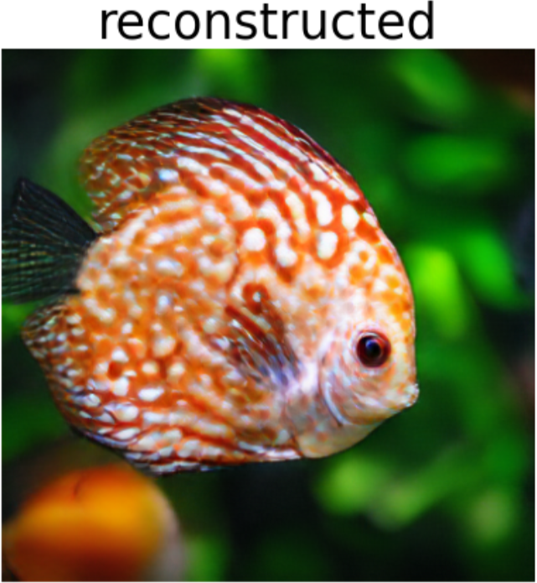
Quick Demo: Fish Image → 576 Integers → Reconstructed Image
Runs the full pipeline: fish image → 576 integers → reconstructed image:
import matplotlib.pyplot as plt
model=load_model() # Loads the pretrained VQGAN (may take a few minutes)
image=process_image("files/fish.png")
sequence=image_to_sequence(model,image) # Converts the image into a sequence of integers
print("the image is converted to:\n", sequence) # Prints out the sequence
reconstruct=sequence_to_image(model,sequence) # Reconstructs the image based on the sequence
imgs=[image[0].cpu().permute(1,2,0)*0.5+0.5, reconstruct[0].cpu().permute(1,2,0)*0.5+0.5]
captions=["original","reconstructed"]
plt.figure(figsize=(8,5),dpi=100)
for i in range(2): # Displays the original and reconstructed images
plt.subplot(1,2,i+1)
plt.imshow(imgs[i].clamp(0,1))
plt.title(captions[i],fontsize=25)
plt.axis('off')
plt.tight_layout()
plt.show()
tensor([ 508, 343, 261, …, 542], device='cuda:0')
576 elements

Slide 34
Section 2
Inside the VQGAN:
Encoder, Quantization
& Decoder

Slide 35
The VQGAN Encoder: Image → Latent Representation
The encoder compresses 3×384×384 to 256×24×24 using 4 strided convolutional layers.
import PIL
import torchvision.transforms as T
import torchvision.transforms.functional as TF
def process_image(file_name): # Defines a process_image() function to center crop images and resize them
size=384
img=PIL.Image.open(file_name)
s = min(img.size)
r = size / s
s = (round(r * img.size[1]), round(r * img.size[0]))
img = TF.resize(img, s, interpolation=PIL.Image.LANCZOS)
img = TF.center_crop(img, output_size=2 * [size])
return torch.unsqueeze(T.ToTensor()(img), 0)*2-1
image1 = process_image("files/cat.png") # Applies the process_image() function on the cat image
print(f"the shape of the original image is {image1.shape}")
z = model.encoder(image1.to(device))
z = model.quant_conv(z)
print(f"the shape of the latent representation is {z.shape}")
Expected output
the shape of the original image is torch.Size([1, 3, 384, 384])
the shape of the latent representation is torch.Size([1, 256, 24, 24])

Slide 36
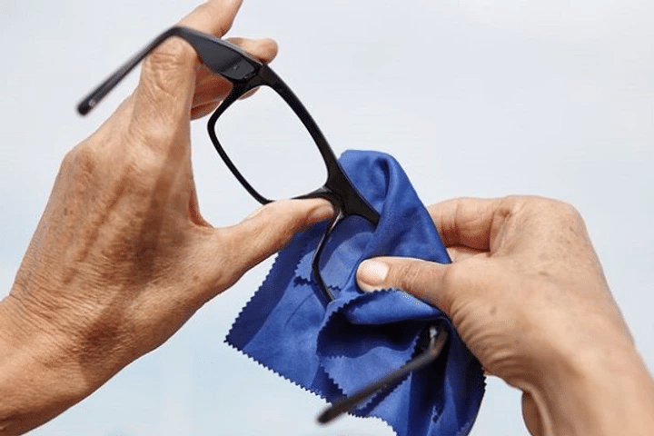
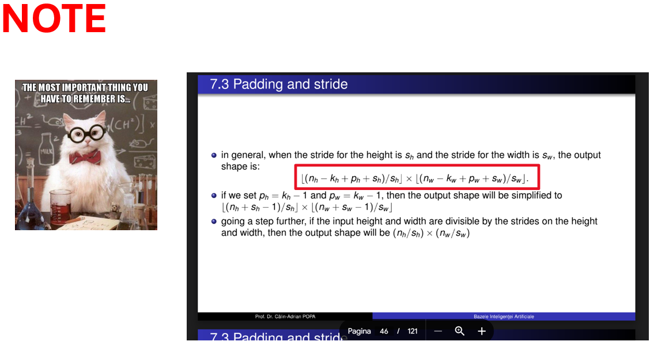
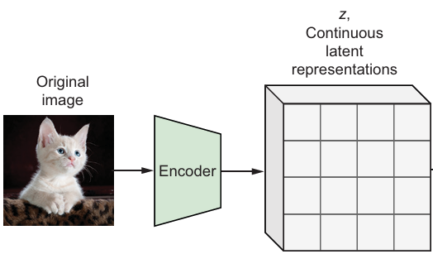

The VQGAN Encoder: Image → Latent Representation
The encoder compresses 1x3×384×384 to 1x256×24×24 using 4 strided convolutional layers.
Shape 1x3×384×384
Shape 1x256x24x24

Slide 37
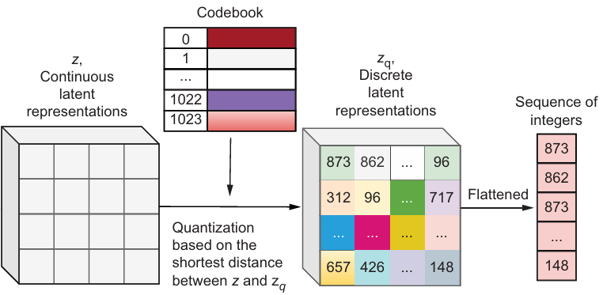
Codebook Quantization: Continuous → Discrete
model.quantize() replaces each latent vector with the nearest entry in the 1024-entry codebook.
z_q, _ , indices= model.quantize(z) # Quantizes the latent vectors by replacing each one with its nearest neighbor in the codebook
int_sequence = indices[2] # Extracts the sequence of integers (indices of the selected codebook vectors)
print(int_sequence)
Expected output
tensor([ 873, 862, 873, …, 148], device='cuda:0')
The codebook is a learnable lookup table of 1024 vectors, each 256-dimensional.
Quantization = nearest-neighbour search in 256-dim space.
The result is a sequence of 576 integers, each in [0, 1023].

Slide 38
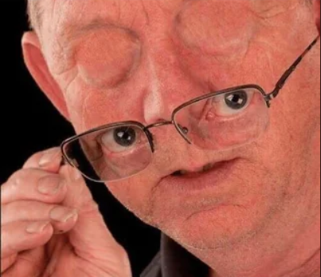
From Integer Sequence Back to a High-Resolution Image
Map each integer to its codebook embedding, reshape, then decode with post_quant_conv + decoder.
z_q2 = model.quantize.embedding(int_sequence)
z_q2 = z_q2.permute(1,0).view(z_q.shape) # Builds a quantized latent representation, z_q2, based on the sequence of integers
z_post2 = model.post_quant_conv(z_q2)
z_recon2 = model.decoder(z_post2) # Converts the latent representation into an image using the VQGAN decoder
z_post = model.post_quant_conv(z_q)
z_recon = model.decoder(z_post) # Reconstructs the cat image using the quantized latent representation, z_q

Slide 39
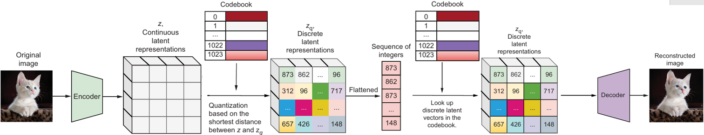
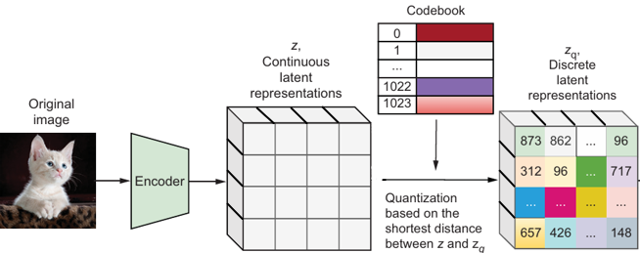
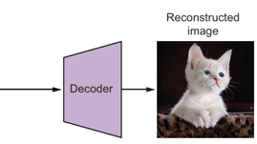
From Integer Sequence Back to a High-Resolution Image
identical reconstructed images
Conclusion? VQGAN is capable to regenerate an image solely from a sequence of integers !

Slide 40
Exercises
01
Process bird.png and bunny.png
Use process_image() on bird.png and bunny.png. Name them image3 and image4. Feed to pretrained VQGAN to get reconstruct3 and reconstruct4.
Hint: Same reconstruct1, reconstruct2 pattern from section 2.1. Use model(image3.to(device)) — returns (reconstruct, ...).
02
Plot all four in 1×4 grid
Place image3, reconstruct3, image4, reconstruct4 in list imgs. Plot 1×4 grid with captions 'original' and 'reconstructed' alternating.
Hint: Same code as section 2.1 for cat and fish. captions = ['original','reconstructed']*2. plt.subplot(1,4,i+1).
03
Quantize the fish image → int_sequence2
Encode image2 through encoder + quant_conv + quantize. Name the quantized latent z2_q and the integer sequence int_sequence2. Print int_sequence2.
Hint: z=model.encoder(image2.to(device)), z=model.quant_conv(z), z2_q,_,indices=model.quantize(z), int_sequence2=indices[2].
04
Reconstruct fish from int_sequence2
Map each integer in int_sequence2 to its codebook embedding using model.quantize.embedding(). Reshape to z_q shape. Decode with post_quant_conv + decoder. Name it z2_recon2.
Hint: z2_q2=model.quantize.embedding(int_sequence2).permute(1,0).view(z2_q.shape). z2_post2=model.post_quant_conv(z2_q2). z2_recon2=model.decoder(z2_post2).
05
Reconstruct from z2_q and compare
Reconstruct fish from z2_q (not int_sequence2) — name it z2_recon. Plot z2_recon and z2_recon2 side by side in a 1×2 grid. They should look identical.
Hint: z2_post=model.post_quant_conv(z2_q). z2_recon=model.decoder(z2_post). plt.subplot(1,2,i+1). Captions: 'reconstructed based on quantized vectors' and 'reconstructed based on sequence of indices'.

Slide 41
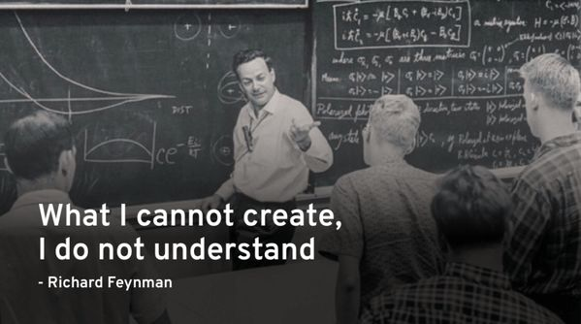

Slide 42
Ex 1
Process bird.png and bunny.png
❓ Download the two images, bird.png and bunny.png. Place the two images in the files folder. Use the process_image() function to process the two images, and name the processed images image3 and image4, respectively. Feed the two processed images to the pretrained VQGAN to obtain two reconstructed images, reconstruct3 and reconstruct4.
import PIL
import torchvision.transforms as T
import torchvision.transforms.functional as TF
import torch
# process_image() is already defined in section 2 of the lab — reuse it
def process_image(file_name):
size = 384
img = PIL.Image.open(file_name)
s = min(img.size)
r = size / s
s = (round(r * img.size[1]), round(r * img.size[0]))
img = TF.resize(img, s, interpolation=PIL.Image.LANCZOS)
img = TF.center_crop(img, output_size=2 * [size])
return torch.unsqueeze(T.ToTensor()(img), 0) * 2 - 1
image3 = process_image("files/bird.png") # (1, 3, 384, 384), range [-1,1]
image4 = process_image("files/bunny.png") # (1, 3, 384, 384), range [-1,1]
print(f"image3 shape: {image3.shape}")
print(f"image4 shape: {image4.shape}")
# Run the full VQGAN encode → quantize → decode pipeline
reconstruct3, _ = model(image3.to(device)) # model() calls encoder+quantize+decoder
reconstruct4, _ = model(image4.to(device))
print(f"reconstruct3 shape: {reconstruct3.shape}")
print(f"reconstruct4 shape: {reconstruct4.shape}")
Expected output image3 shape: torch.Size([1, 3, 384, 384])
image4 shape: torch.Size([1, 3, 384, 384])
reconstruct3 shape: torch.Size([1, 3, 384, 384])
reconstruct4 shape: torch.Size([1, 3, 384, 384])

Slide 43
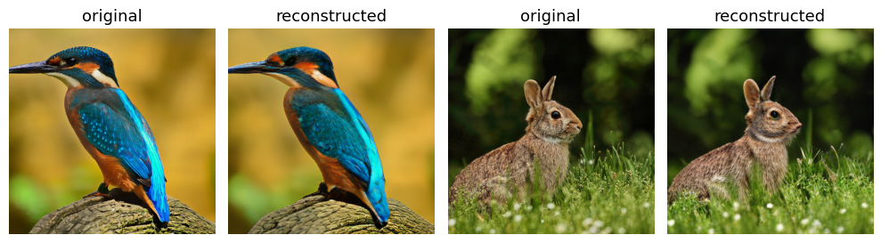
Ex 2
Plot all four in 1×4 grid
❓ Place the two original images, image3 and image4, and the two reconstructed ones, reconstruct3 and reconstruct4, in a list imgs. Plot the four images in a 1×4 grid, and add a caption of either original or reconstructed above each image.
import matplotlib.pyplot as plt
imgs = [
image3[0].cpu().permute(1, 2, 0) * 0.5 + 0.5, # bird original
reconstruct3[0].cpu().permute(1, 2, 0) * 0.5 + 0.5, # bird reconstructed
image4[0].cpu().permute(1, 2, 0) * 0.5 + 0.5, # bunny original
reconstruct4[0].cpu().permute(1, 2, 0) * 0.5 + 0.5, # bunny reconstructed
]
captions = ["original", "reconstructed"] * 2 # alternates for all 4
plt.figure(figsize=(10, 3), dpi=100)
for i in range(4):
plt.subplot(1, 4, i + 1)
plt.imshow(imgs[i].clamp(0, 1)) # clamp prevents display artefacts
plt.title(captions[i], fontsize=13)
plt.axis("off")
plt.tight_layout()
plt.show()

Slide 44
Ex 3
Quantize the fish image → int_sequence2
❓ Find out the quantized latent representation for the fish image, and name it z2_q. Find out the sequence of integers that represent the fish image, and call it int_sequence2. Print out the 576 values in int_sequence2.
# image2 was defined in section 2 of the lab: process_image("files/fish.png")
z2 = model.encoder(image2.to(device)) # continuous encoder output
z2 = model.quant_conv(z2) # project to codebook dimension
print(f"latent z2 shape: {z2.shape}") # → (1, 256, 24, 24)
z2_q, _, indices = model.quantize(z2) # nearest-neighbour quantization
int_sequence2 = indices[2] # flat integer sequence
print(f"z2_q shape: {z2_q.shape}") # → (1, 256, 24, 24)
print(f"int_sequence2 shape:{int_sequence2.shape}") # → (576,)
print("int_sequence2:\n", int_sequence2) # prints 576 integers (0–1023)
Expected output latent z2 shape: torch.Size([1, 256, 24, 24])
z2_q shape: torch.Size([1, 256, 24, 24])
int_sequence2 shape: torch.Size([576,])
int_sequence2: tensor([508, 343, 261, ..., 534, 330, 542])

Slide 45
Ex 4
Reconstruct fish from int_sequence2
❓ Map each integer in int_sequence2 to its corresponding feature vector in the codebook to assemble a complete quantized latent representation z2_q2. Pass z2_q2 through the VQGAN decoder to reconstruct the fish image, and name the reconstructed image z2_recon2.
# Step 1: look up each integer in the codebook embedding table
z2_q2 = model.quantize.embedding(int_sequence2) # shape: (576, 256)
# Step 2: reshape back to spatial latent format
z2_q2 = z2_q2.permute(1, 0).view(z2_q.shape) # shape: (1, 256, 24, 24)
# permute(1,0) → (256, 576)
# view(z2_q.shape) → (1, 256, 24, 24)
# Step 3: post-quantization convolution (symmetric to quant_conv)
z2_post2 = model.post_quant_conv(z2_q2) # shape: (1, 256, 24, 24)
# Step 4: decode to high-resolution image
z2_recon2 = model.decoder(z2_post2) # shape: (1, 3, 384, 384)
print(f"z2_recon2 shape: {z2_recon2.shape}")
Expected output z2_recon2 shape: torch.Size([1, 3, 384, 384])

Slide 46
Ex 5
Reconstruct from z2_q and compare
❓ First, reconstruct the fish image based on the quantized latent representation first generated, z2_q, in Exercise 3, and name the reconstructed fish image z2_recon. Plot z2_recon and z2_recon2 side by side in a 1×2 grid to compare them.
import matplotlib.pyplot as plt
import torch
z2_post = model.post_quant_conv(z2_q) # skip quant_conv — z2_q already quantized
z2_recon = model.decoder(z2_post) # shape: (1, 3, 384, 384)
# Plot side by side in a 1×2 grid
imgs = [
z2_recon[0].cpu().permute(1, 2, 0) * 0.5 + 0.5, # from z2_q
z2_recon2[0].cpu().permute(1, 2, 0) * 0.5 + 0.5, # from int_sequence2
]
captions = [
"reconstructed based on\nquantized vectors",
"reconstructed based on\na sequence of indices",
]
plt.figure(figsize=(8, 4), dpi=100)
for i in range(2):
plt.subplot(1, 2, i + 1)
plt.imshow(imgs[i].clamp(0, 1))
plt.title(captions[i], fontsize=14)
plt.axis("off")
plt.tight_layout()
plt.show()
# Verify they are numerically identical
print("Max pixel difference:", (z2_recon - z2_recon2).abs().max().item())

Slide 47
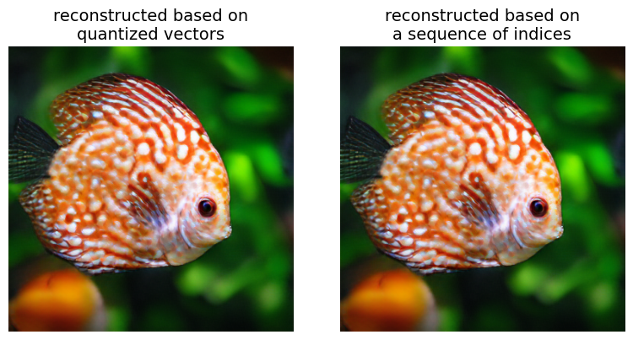
Ex 5
Reconstruct from z2_q and compare
❓ First, reconstruct the fish image based on the quantized latent representation first generated, z2_q, in Exercise 3, and name the reconstructed fish image z2_recon. Plot z2_recon and z2_recon2 side by side in a 1×2 grid to compare them.
Max pixel difference: 1.3649463653564453e-05

Slide 48
Thank you !

